Slide 1
Business Analysis
January 18, 2021

Slide 2
Objective:
Increase sales and customer satisfaction.

Slide 3
Key Points
Keep things simple
Exciting AI Features
Customer Satisfaction
We have to keep the things as simple as possible. According to one of our reviewer, the things are not intuitive at all.
AI can help businesses increase sales, improve customer experience, automate work processes and provide predictive analysis.
Customer Satisfaction is a leading indicator to measure customer loyalty, identify unhappy customers, reduce churn and increase revenue.

Slide 4
Keep things simple

Slide 5
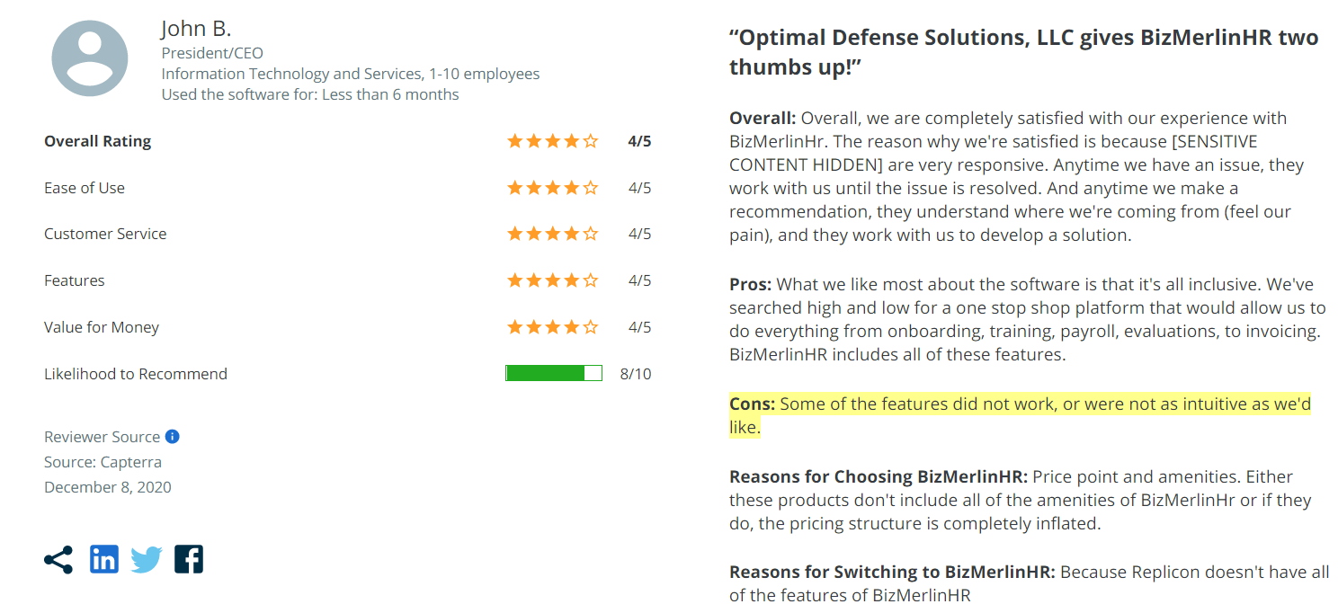
Keep things intuitive

Slide 6
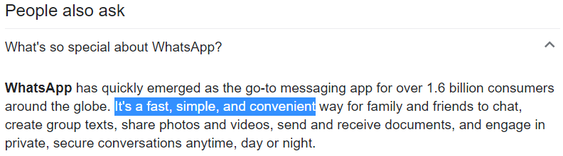
Why Whatsapp is so popular and used among every customer segment?

Slide 7
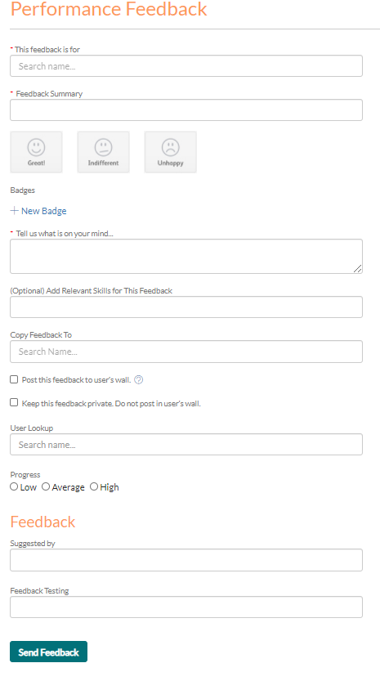
We can book a cab from Uber in just 3 clicks.
We can order the food from Zomato/Swiggy in just 3 clicks.
We can book the movie ticket from BookMyShow in just 3 clicks.
But in our software if we want to just give a feedback to a person then we need to fill a form of 12 fields.
Recommendation: Only show the things that are really important, and hide (not remove) the other things just like other successful companies do like WhatsApp, Uber etc.

Slide 8
Exciting AI Features

Slide 9
How are businesses using artificial intelligence?
Improve customer services - Use virtual assistant programs to provide real-time support to users
Predict performance - Use AI applications to determine when you might reach performance goals, such as response time to help desk calls.
Predict behaviour - Use ML algorithms to analyse patterns of online behaviour. For example, detect credit card fraud or target appropriate adverts.
Manage and analyse your data - AI can help you interpret and mine your data more efficiently than ever before and provide meaningful insight into your assets, your brand, staff or customers.
Improve your marketing and advertising - For example, effectively track user behaviour and automate many routine marketing tasks.

Slide 10
Some of the areas in our software where we can use artificial intelligence

Slide 11
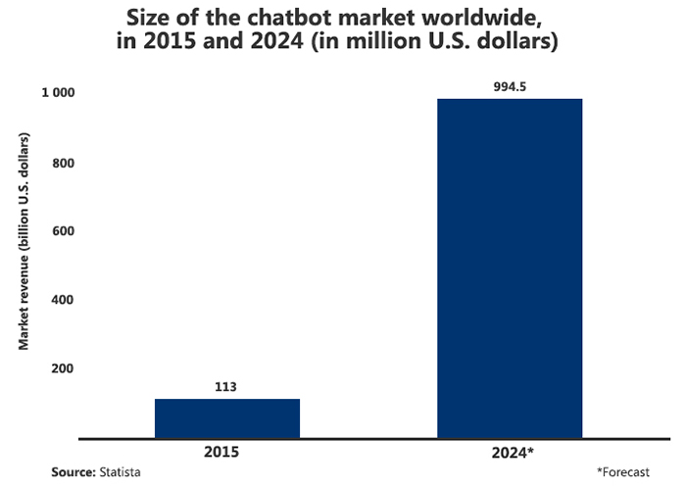
Virtual Assistant
Chatbots are easily one of the most well-known examples of artificial intelligence. They're useful in a business because they save time and effort by automating various aspects of customer support. According to Gartner, by 2021, around 85% of our interactions will be handled by bots instead of humans.
By using virtual assistant we can handle 24x7 customer service without any human interaction.

Slide 12
Some other exciting features where AI can help us to increase the customer satisfaction.
Identify the right people for promotion
Identify who is leaving
Recommend the right training
Sentiment analysis of the given feedback or reviews
Doing things like clock in or assign training to someone via voice command
Notification reader
And the list goes on…..

Slide 13
Understanding the customer

Slide 14
Data Collection
We are lacking in data collection. In order to understand customer needs we need to ask right questions to user.
Data can be collected by :-
Doing Surveys
By getting feedback
Recommendation: The survey and feedback forms should be small and simple so that user can fill it in within 10 seconds. But it should be so precise and to the point that we get what we want in those 10 seconds.

Slide 15
Conclusions
Try to keep things as simple as possible and hide the things that are not useful to user.
The world is moving towards artificial intelligence and this is the right time for us to have a transition towards AI, otherwise it will be too late as our competitors have started moving towards it.
In order to understand customer we need to ask right questions to the customer. We need to collect as much data as possible in order to get insights from that data.

Slide 16

Made by
Sameer Sharma, Business Analyst

